Slide 1
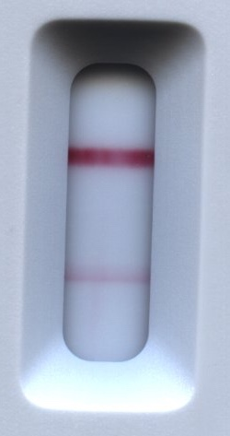
Standardized signal quantification method is required for many purposes
0
15
Experimental conditions (Input) | Signal intensities (Output 1) | Normalized to the score (Output 2)
pH 8-9 for conjugation | 0-255 | 0-15
Sample pad types | 0-255 | 0-15
Detergent types | 0-255 | 0-15
… | … | …
Score
∙ ∙ ∙ ∙ ∙ ∙ ∙ ∙
Signals
20 data/day/project → 2 months for 1000 data
I have Matlab code, but any software would be fine
Internal purposes:
Know the score right after scan (i.e. no naked eye detection in R&D)
Compare signal intensities in different experiments (at least in R&D)
Design of experiment to expect input to achieve target sensitivity
Big data (~1000)
External purposes:
App for cell phone detection to know positive/negative by end user

